Slide 1
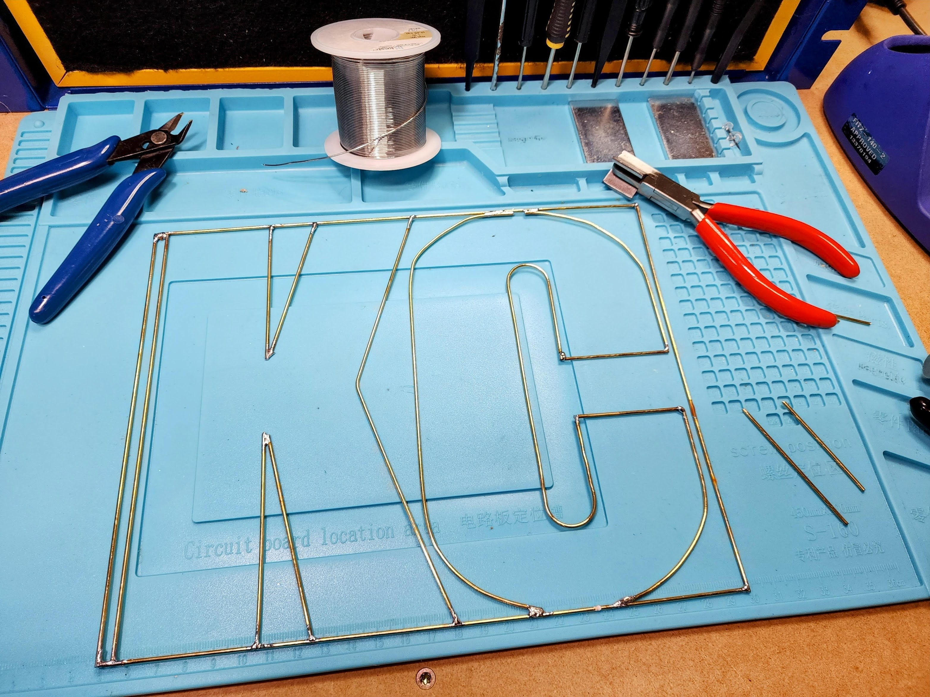
Guidelines
Try not to solder near the rod solder joints so they don’t come a part
This will be framed so please try and keep the components flat as much as possible and not raised above the brass rods
Fill in the inside of the ‘KC” only please
Be creative!
Community Solder Art Project

